Slide 1

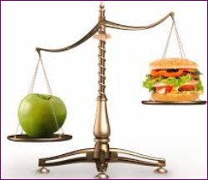
DIET TRACKER
A SMART SOLUTION FOR ENHANCED DIETARY HABITS
AUTHOR: VALARY AYUMA
DATE: 19TH AUGUST 2024

Slide 2

PROJECT OVERVIEW
Objective:
Develop a user-friendly mobile application to track dietary habits.
SDG Alignment:
Goals 2 (Zero Hunger) and 3 (Good Health and Well-Being).
Mission: Promote healthier eating habits and provide nutritional insights to improve overall well-being.

Slide 3
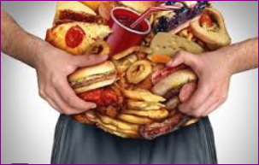

PROBLEM DEFINITION
The Problem:
Increasing rates of obesity and dietary-related illnesses globally.
Lack of awareness about nutritional values and healthy eating.
Significance:
Addressing these issues can lead to improved health outcomes and reduced healthcare costs.
Aligns with global health initiatives and supports sustainable diet practices.

Slide 4
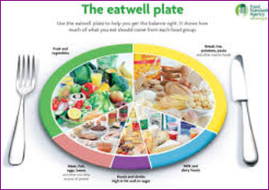
TARGET AUDIENCE
We Serve: Individuals (students, professionals, families) seeking to improve their diet.
Health organizations wanting to monitor community health.
Dietitians and nutritionists for client management.

Slide 5
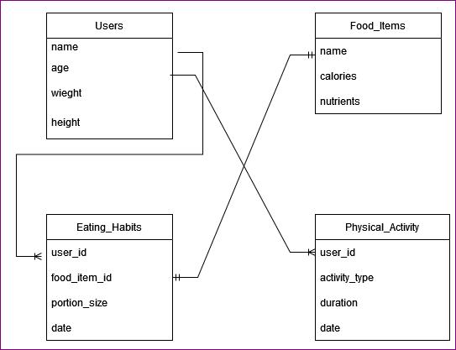

DATABASE DESIGN AND SCHEMA
Overview:
Data Storage: Users, Food Items, Eating Habits, Physical Activities, and Analytics.
Schema Example:
Users: user_id, name, age, weight, height
Food_Items: food_item_id, name, calories, proteins, carhydrates, fats.
Eating_Habits: eating_habit_id, user_id, food_item_id, portion_size, eating_date
Physical_Activity: activity_id, user_id, activity_type, duration, activity_date

Slide 6

DATA ANALYSIS INSIGHTS
Insights Gained:
Trends in dietary habits and common food choices across demographics.
Correlation between physical activity and dietary intake.
Identification of food groups most consumed and areas needing improvement.
Visual Representation: Includes charts representing these insights.

Slide 7
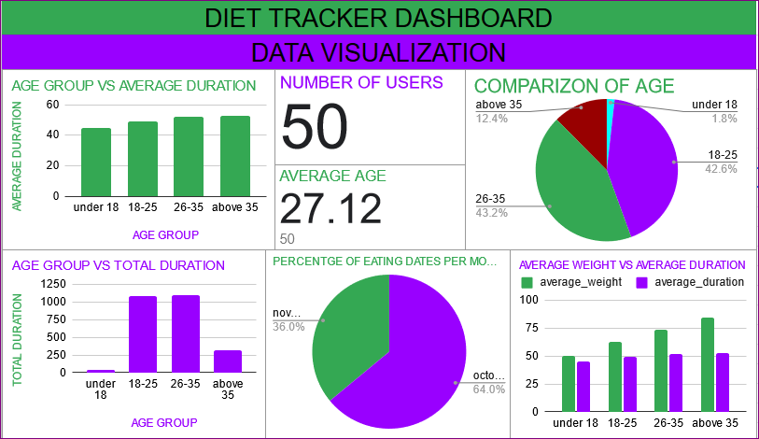
EXCEL DASHBOARD DEMONSTRATION
Dashboard Features:
User-friendly interface displaying:
Age group vs average duration.
Number of users.
Average age.
Comparison of age.
Age group vs total duration.
Percentage of eating dates per month.
Average weight vs average duration.

Slide 8

USER ENGAGEMENT AND MOTIVATION
Engagement Strategies:
Gamification: Rewards and achievements for hitting nutritional goals.
Community features: Connect users for accountability and support.
Personalized reminders and tips based on user behavior.

Slide 9

FUTURE ROADMAP
Next Steps:
Prototype development and user testing.
Partnerships with health organizations and nutritionists.
App launch strategies and marketing plan.
Long-Term Goals: Continuous improvement based on user feedback and data analytics.

Slide 10

CALL TO ACTION
Join Us and be part of promoting healthier lifestyles!
Funding Opportunities: Seeking investors or partnerships for development.
Contact Information;
Email: valaryayuma03@gmail.com
Contact: +254 757 184 454
THANK YOU.

